Slide 1
Deep Natural Language Processing for User Representation
Traitement du langage naturel profond pour la modélisation d’utilisateurs
Clara Gainon de Forsan de Gabriac – 13 décembre 2021
JURY DE THESE
Rapporteurs
Anne Boyer
Julien Velcin
Examinateurs
Mohamed Chetouani
Alejandro Bellogin
Encadrants
Patrick Gallinari
Vincent Guigue
Notes:
Hello everyone.
Thank you all for being here today.
During the next 45 minutes, I’ll be presenting the work conducted during my PHD, called : Deep Natural Language Processing for user representation

Slide 2

The Information Era
Illustration of Netflix recommendations
Ever-growing quantity of data to choose from
Multiplication of user (textual) traces
Notes:
In the past decades, the rise of internet led to an explosion of data and online services: movies on Netflix, stuff on amazon and so on.
Additionally, the number of interactions between users and those systems keeps increasing, namely in the form of textual traces such as reviews.

Slide 3
The Information Era
Illustration of Netflix recommendations
Ever-growing quantity of data to choose from
Multiplication of user (textual) traces
Challenge: present users with relevant items
Notes:
This situation brings a challenge: to present users with a subset of relevant items rather than the whole catalog to ease their search.
Note that the notion of relevance is a complex one to define and it is highly discussed in the community.
In this work, we will consider an item to be relevant if it is personalized and if we can explain why it is consistent with the user’s profile.

Slide 4
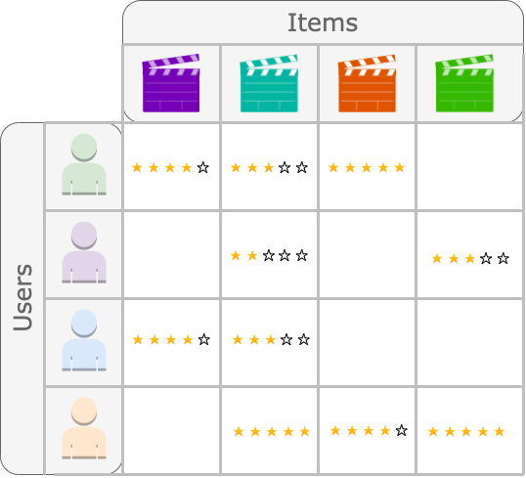
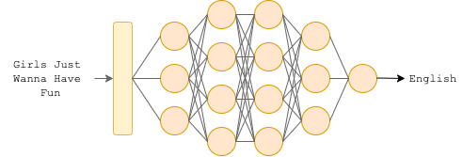
Artificial Intelligence and Deep Learning
Schema of a language classifier
A user-item Matrix (Collaborative Filtering)
Computer Vision
Recommendation
Natural Language Processing
…
Rise of AI for numerous applications:
Notes:
This challenge, brought on by the recent industrial developments, is a classic Recommendation Problem, that is often addressed by Machine Learning algorithms, and namely, Matrix Factorization.
Matrix Factorization, which can be seen as an early instance of Representation Learning, has been the preferred approach to Recommendation since the focus shifted from content-based models to the Collaborative Filtering Approach.
It is only recently that Deep Learning Models found their way to this domain – which can be attributed to the trend of content analysis, in which Deep Learning takes place.
Machine Learning, and in particular Deep Learning models have grown very popular in the past few years because they can be applied to various domains, ranging from Computer Vision to Recommendation to Natural Language Processing.

Slide 5
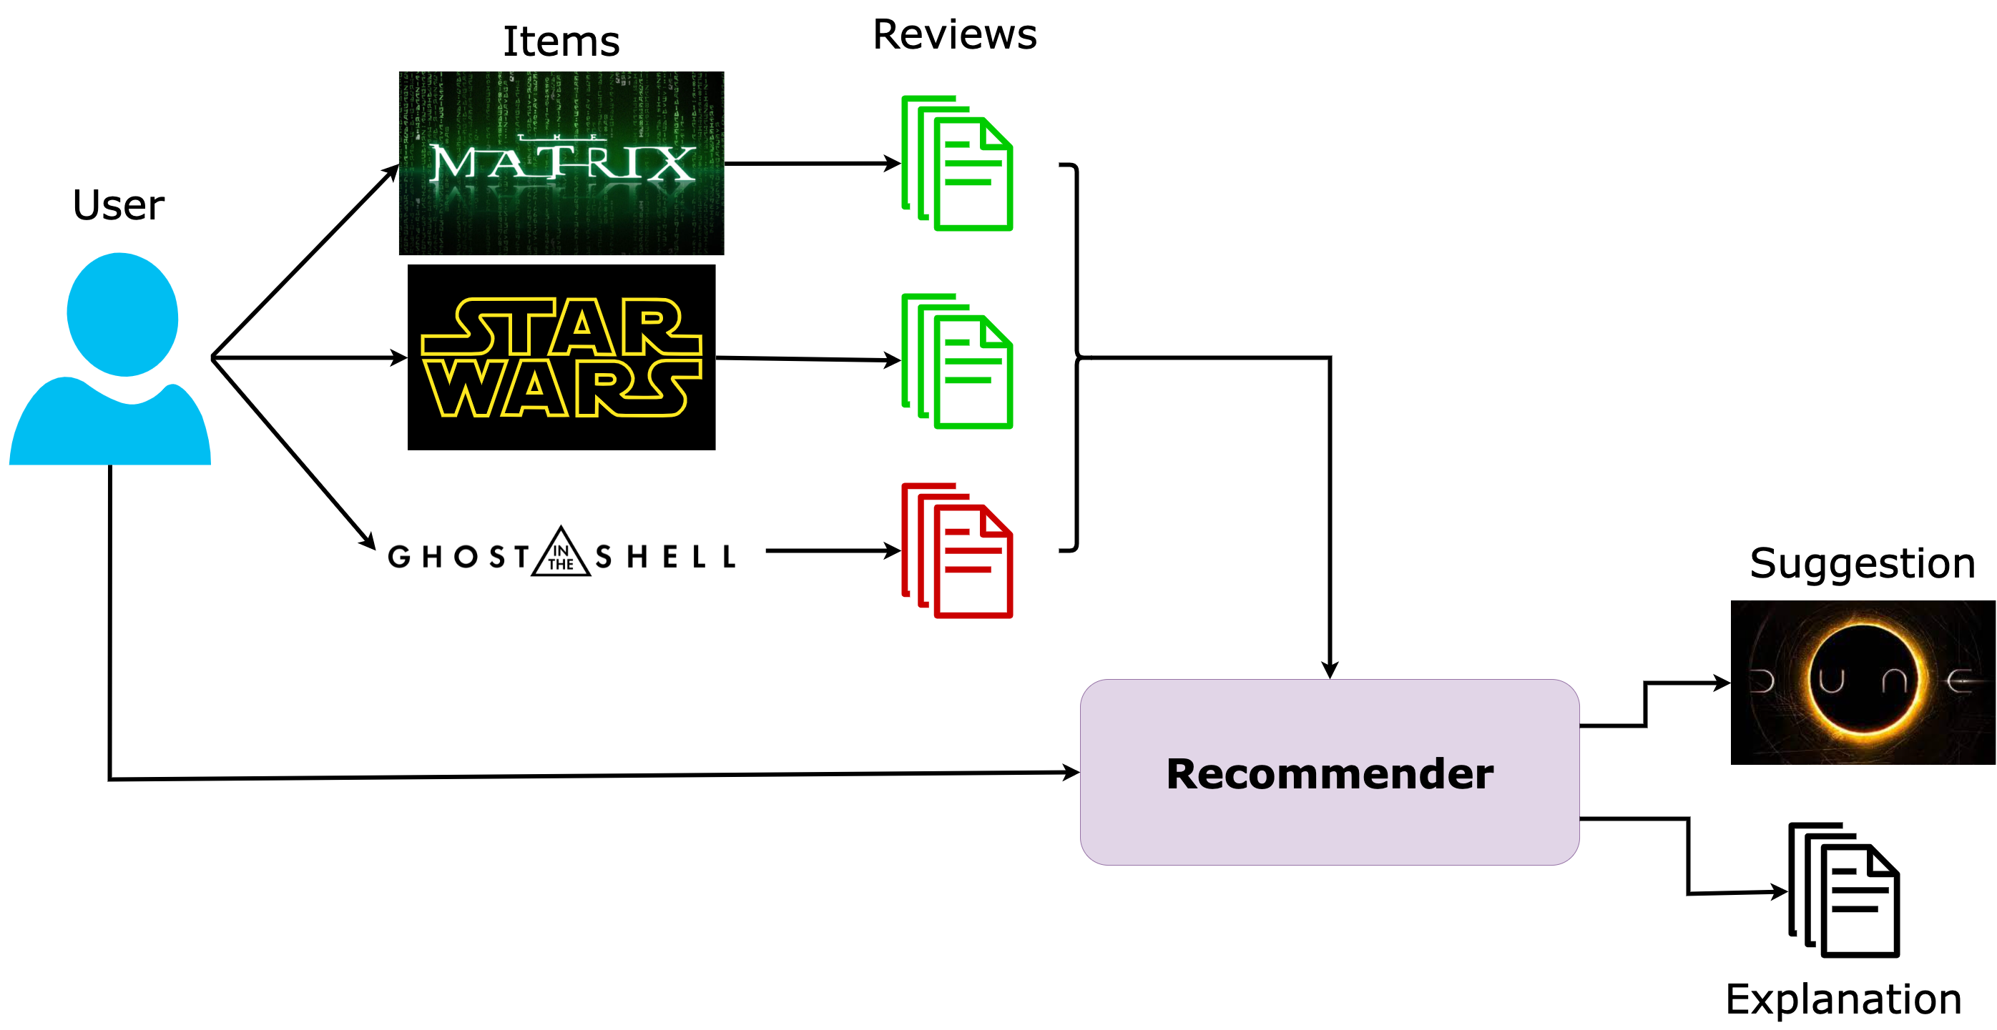
Deep NLP for user representation
Goal
Refining user representations with user-generated texts for explainable predictions.
Notes:
In this work, we are particularly interested in those last two domains, as we aim at leveraging user-generated texts, such as reviews, in order to understand their profile and emit relevant predictions that we can explain.
Let’s get more into details.

Slide 6
Problematics
Rich User
Representation
What
Understand the users’ tastes
Model diversity and complexity of their profiles
How
Recommendation [1], [2]
Representation Learning
[1] G. Ganu et al., 2009, [2] J. McAuley et al., 2013
Notes:
In order to propose relevant recommendations, one must first understand the user.
In other words, we want to build rich user representations in the sense that they can model complex and diverse aspects of their profiles.
This goal has been at the heart of the Recommendation domain since the focus shifted from item-centric models to user-centric ones.
Namely, Ganu et al. have explored the multi aspect quality of textual reviews, by explicitly modeling them.
McAuley et al. also used textual reviews by discovering and leveraging hidden factors within them.
Our approach is closer to this last method, as we implicitly model various aspects of the users, in the spirit of Representation Learning.

Slide 7
Problematics
Rich User
Representation
Leverage
User-generated
Text
What
Use users’ textual traces
Identify what defines / matters to the user
How
Word embedding [1]
Sequence modeling [2]
Attention mechanisms [3]
[1] P. Bojanowski et al., 2016, [2] M. Peters et al., 2018, [3] D. Bahdanau et al., 2016
Notes:
We choose to address User Representation by the leveraging of user-generated text.
Aside from this type of data being widely available, we think it Is also highly descriptive of the users themselves.
It is especially clear when we think of written reviews: the users often state what they like and dislike about a product, giving us a lot more information than the rating alone.
From a broader point of view, one can think of text as highly descriptive of a user because the words and the syntax they use to talk about their experiences are somewhat unique to them.

Slide 8
Problematics
Rich User
Representation
Leverage
User-generated
Text
What
Provide insights regarding the model’s predictions and / or the user’s representation
Make Predictions Explainable
How
Inherently explainable models [1]
Post-hoc frameworks [2]
Text Generation [3]
[1] J. Fürnkranz, 2010 , [2] M.T. Ribeiro et al., 2016, [3] L.A., Hendricks et al. 2016
Notes:
This choice to focus on user-generated text, along with the advances of generative models, also allows us to explore the explainability of our models’ predictions, which we consider to be one of the biggest challenges faced by Deep Learning and Artificial Intelligence in general.
The development of Deep Learning models allowed for the representation of complex objects, but it also made those representations very abstract and thus, gave rise to a need for explainability.
It is our opinion that, if AI is to take a bigger place in our society, then we must be able to understand or at least explain the predictions it gives.
In the case of User Representation, this translates into the need to understand how the system represented the user.
Explainability is a vast domain that englobes a lot of different approaches, from inherently explainable models to post-hoc, perturbation-based models and frameworks.
In this work, we focus on one particular approach, which we consider to be one of the purest form of representation learning: text generation.
Indeed, generating relevant text from a latent representation implies that you have achieved a good, meaningful representation of the input.

Slide 9
Problematics
Rich User
Representation
Leverage
User-generated
Text
What
Learn versatile, explainable user representations using textual traces.
Make Predictions Explainable
This Work
How
By using
Recommendation
NLP
Text Generation
In a Representation Learning paradigm.
Notes:
The work presented in this thesis is motivated by those three aspects.
We want to use user-generated texts to build versatile, meaningful and explainable representations.
We tackle this problem by combining methods that come from the Recommendation, the NLP and the text generation communities.

Slide 10
Motivations and contributions
Motivations
Axes
Contribution
Rich, versatile user representation
Recommendation
1
HRAN
Leverage user-generated text
Natural Language Processing
2
Resume
Make predictions explainable
Text Generation
Notes:
In our first contribution, HRAN, we will combine Recommendation and NLP methods to refine our understanding of user tastes in a classic Recommendation setting.
In our second contribution, Resume, we propose a framework to learn and evaluate user professional profiles, a new task, by combining classic NLP methods to Text generation models.

Slide 11
Motivations and contributions
Motivations
Axes
Contribution
Rich, versatile user representation
Recommendation
1
HRAN
Leverage user-generated text
Natural Language Processing
2
Resume
Make predictions explainable
Text Generation
Representation Learning[1]
[1]Y. Bengio et al., 2013
Notes:
In this work, we address all three axes of Recommendation, NLP and text generation through the lens of Representation learning, which is a paradigm defined by the fact that all representations live in a continuous latent space.
Representation Learning focuses on learning abstract, rich and reusable representations.

Slide 12
Outline
Refining User Understanding In Recommendation Via NLP (HRAN)
An NLP Approach To Professional Profile Learning And Evaluation (Resume)
User Dynamic Modeling (exploratory)
Conclusion & Perspective
Notes:
The presentation is thus organized as follows:
We will first go over our first contribution, HRAN.
Then, we will present Resume, a text-based framework for user representation.
We will also present some exploratory work on user dynamic modeling, before offering some perspective and concluding.

Slide 13
REFINING USER UNDERSTANDING IN RECOMMENDATION VIA NLP
RNN & modèle d’attention pour l’apprentissage de profils textuels personnalisés
Charles-Emmanuel Dias, Clara Gainon de Forsan de Gabriac, Vincent Guigue, and Patrick Gallinari CORIA 2018
Notes:
[6:00 - 6:30]
Let’s begin with our HRAN model, which was published at the CORIA conference of 2018.

Slide 14
Motivation and intuition
Motivation
Refining user understanding
Good prediction accuracy
Prediction Explainability
Intuition
Reviews can help improve performances
& make predictions understandable.
Notes:
This work is motivated by the will to improve a recommender’s accuracy performances by refining our understanding of the user, as well as the explainability of the model’s predictions.
The intuition behind this contribution is that reviews can help improve performances & make predictions understandable, by highlighting the user’s preferences.

Slide 15


Motivation and intuition
Motivation
Refining user understanding
Good prediction accuracy
Prediction Explainability
Intuition
Reviews can help improve performances
& make predictions understandable.
Approach
Rating regression
+
Sentiment analysis
Hierarchical Recurrent Attentive Network
Sentiment Analysis
Polarity
Prediction
Reviews
$$\hat{r_{u,i}}$$
User profile +
Item profile
Recommendation
Rating
Prediction
$$\hat{r_{u,i}}$$
Notes:
We implement this intuition by combining a traditional recommendation module to an attentive sentiment analysis module.
The resulting model is called HRAN, for Hierarchical Recurrent Attentive Network.
The sentiment analysis part takes the reviews as input, while the recommendation module takes both the user and the item profiles as input.
Both parts of the model output the same object: the rating that user u gave item I, r_u,i.
While those two tasks are rarely combined, because they are quite different, in this precise setting they are complementary.
The Sentiment Analysis module gives us a global, absolute idea of the feeling expressed in the review, and thus acts as a regularization for the recommendation module, which informs us more precisely regarding the user-item interaction.
Note that both modules share inner intermediate representations to refine the models’ understanding of the user’s tastes, which we will detail in the next slides.

Slide 16


Motivation and intuition
Collaborative Filtering
Leveraging Textual reviews for recommendation [1]
Hierarchical Attentive Network for document classification [2]
Approach
Rating regression
+
Sentiment analysis
Hierarchical Recurrent Attentive Network
Sentiment Analysis
Polarity
Prediction
Reviews
$$\hat{r_{u,i}}$$
User profile +
Item profile
Recommendation
Rating
Prediction
$$\hat{r_{u,i}}$$
[1] J. McAuley and Leskovec, 2013, [2] Z. Yang et al., 2016
Notes:
We tackle this recommendation problem with a collaborative filtering approach as we are interested in the interactions between the users and the items.
Additionally, and similarly to McAuley and Leskovec, we make use of the available textual reviews to refine our understanding of the user’s tastes.
We also largely build on the work of Yang et al and their Hierarchical Attentive Network (or HAN for short) for document classification, which we adapted to our problematics in the sentiment analysis module.

Slide 17
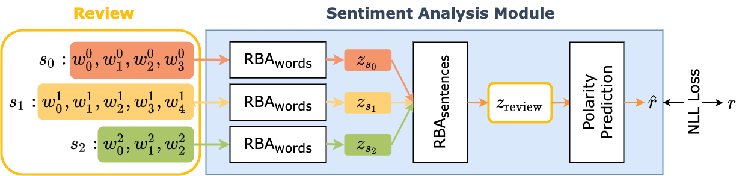
The model : HRAN, Sentiment Analysis Module
Illustration of the sentiment analysis module.
Reviews are hierarchical (words, sentences, review)
→ Aggregation Problem
Notes:
Let’s take a closer look at the Sentiment Analysis module.
Similarly to Yang et al.'s documents, our reviews are by essence hierarchical as they are composed of sentences, themselves composed of words.
On top of that, we make the hypothesis that the information contained in the reviews are, too, hierarchical.
In other words, we want to understand what words are most important in a sentence, and what sentences are most important in a review.
Thus, the challenge is to aggregate the data in the review in a way that allows us to predict the review’s overall polarity, which is what the sentiment analysis module is trained to do.

Slide 18
The model : HRAN, Sentiment Analysis Module
Illustration of the sentiment analysis module.
Reviews are hierarchical (words, sentences, review)
→ Aggregation Problem
Solution
Attention mechanism
Z. Yang et al., 2016
Notes:
We handle this problem by using an attention mechanism like Yang et al: with two sequential Recurrent Bidirectional Attentive modules, or RBA, which we describe in detail in the following slide.
The first RBA aggregates the words of a sentence into a representation of this sentence, z_s, which is in turn fed to the sentence-level RBA and aggregated to form the final review representation, z_review.
This whole module is then trained to optimize a Negative Log Likelihood Loss between the predicted rating and the actual rating.
Note that this polarity prediction task takes the form of a 5-class classification task.
Each corresponding to a possible rating, can be understood as the level of enthusiasm contained in the review.
Let us now dive into the RBA in details.

Slide 19
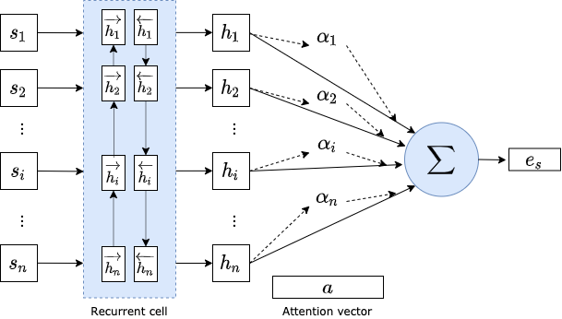
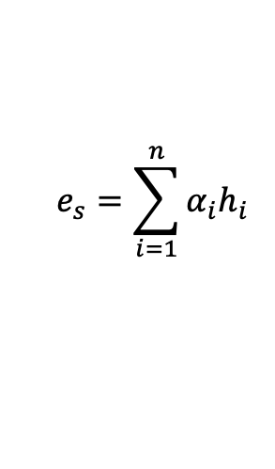
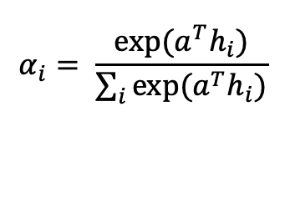
The model : HRAN, RBA
Hierarchical attention networks for document classification
Yang, Zichao and Yang, Diyi and Dyer, Chris and He, Xiaodong and Smola, Alex and Hovy, Eduard, in: ACL 2016.
$$α_{i}= \frac{exp⁡(a^{T}h_{i})}{\sum_{i}{exp⁡(a^{T}h_{i})}}$$
$$e_{s}=\sum_{i=1}^{n}{α_{i}h_{i}}$$
Notes:
As its name indicates, the RBA module is composed of a bi-directional recurrent cell coupled to an attention mechanism.
The sequence is encoded from both sides in order to capture the intra sequence information.
Bidirectional encoding is particularly useful when the sequences are long, because it prevents the forgetting of the sequence’s beginning.
The forward and backward annotations are then concatenated in a single vector, h.
This newly formed hidden state is then multiplied in a dot product with a learned attention vector, a.
The results of this dot product is then passed into a softmax to obtain the attention scores of each hidden state in the final sentence representation e_s.
These equations are the main part of attention and can be understood as the way the model learns to recognize important words in the sentence.
This is the classic way to compute attention scores.
But the originality of our approach lies in our personalized attention computation.

Slide 20
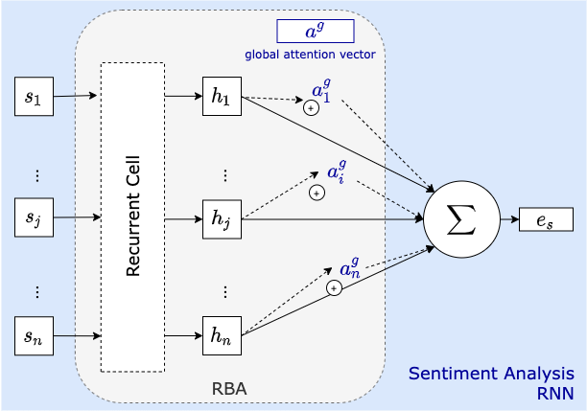
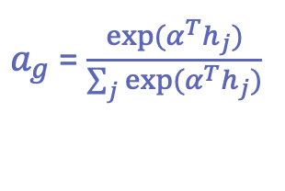
The model : HRAN, personalized attention
$a_{g}$ = $\frac{exp⁡(α^{T}h_{j})}{\sum_{j}{exp⁡(α^{T}h_{j})}}$
Notes:
The main idea of our approach to attention is that we want to refine our understanding of the user by modeling both a general attention component, relative to the language used in the reviews, and a personalized attention component, computed from the interaction between the user and the target item.
The global component of this attention, a_g, is computed from the review’s elements, similarly to the previous slide.
It represents what elements of the sequence are the most important from a general language point of view.
In the next slides we will present some attention visualization that show that this generalist component highlight opinion terms like “great”, “best” etc.

Slide 21
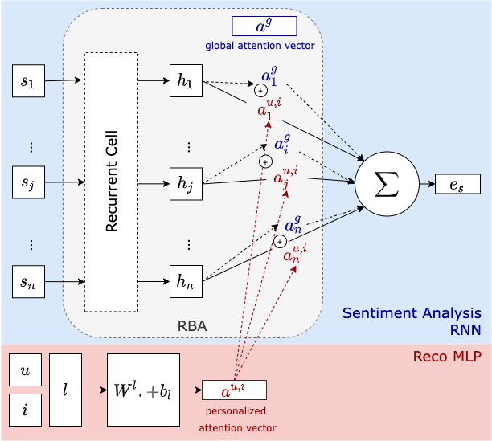
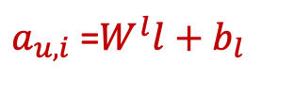
The model : HRAN, personalized attention
$a_{g}$ = $\frac{exp⁡(α^{T}h_{j})}{\sum_{j}{exp⁡(α^{T}h_{j})}}$
$a_{u,i}$ =$W^{l}l+b_{l}$
Notes:
Then comes the personalized attention, denoted a_u,i.
This component is computed from the user and item profiles in the recommendation part of the HRAN model.
The user and item profiles are concatenated into a vector L, that is itself projected into the space of the global attention vector via a matrix W and a bias b.

Slide 22
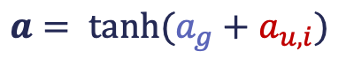
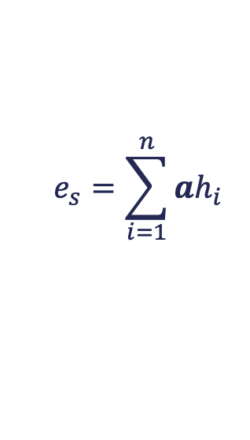
The model : HRAN, personalized attention
$a_{g}$ = $\frac{exp⁡(α^{T}h_{j})}{\sum_{j}{exp⁡(α^{T}h_{j})}}$
$a_{u,i}$ =$W^{l}l+b_{l}$
$$a= \tanh{(a_{g}+a_{u,i})}$$
$$e_{s}=\sum_{i=1}^{n}{ah_{i}}$$
Notes:
The two components are then added, and the final attention vector is then smoothed with a hyperbolic tangeant to be bounded between -1 and 1.
The final sequence representation, e_s, is then computed with this attention vector, that accounts for both the generalist and the personalized components.

Slide 23
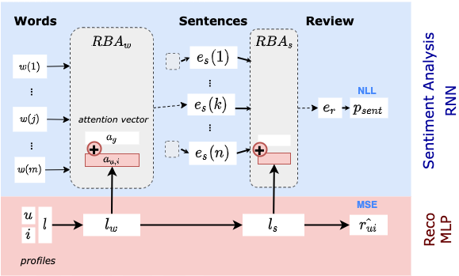
The model : HRAN, overview
Hierarchical Information → Multi-Level Personalization
Attention: Regularization, Personalized Aggregation, Explanation
Notes:
Since the reviews contain inherently hierarchical information, our model too has to be hierarchical.
Therefore, the attention computation we just described takes place at both the word and the sentence level, in order to obtain a representation of the whole review.
In this architecture, the attention mechanism addresses many problems.
It acts as a regularization, provides a personalized aggregation method and it also allows us to present qualitative analysis of our results by showing which words and sentences were most determinant in the input.
This hierarchical attention mechanism also proved to be decisive in the process of sentiment analysis:

Slide 24
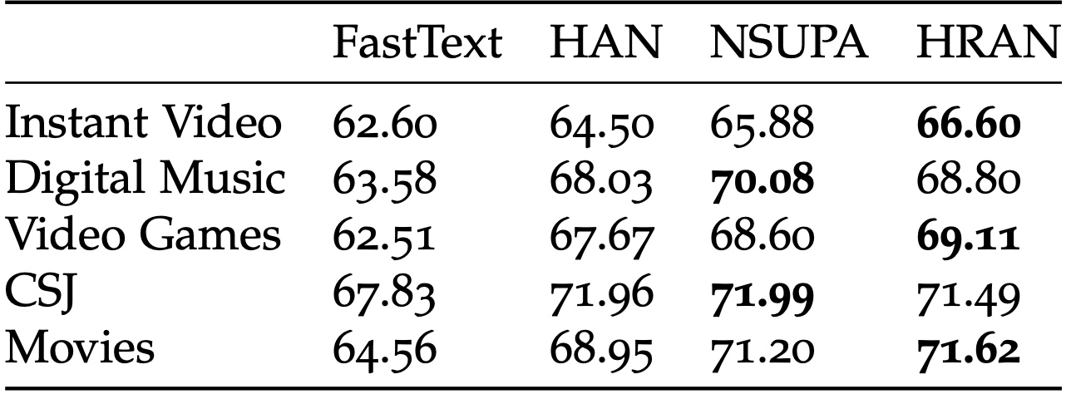
Results – sentiment analysis
[1]
[2]
[3]
Accuracy metric on the sentiment analysis task.
Hierarchical Attentive models show better performances
Modeling the user/product bias improves performances
Our approach is competitive with the then SOTA models
[1] P. Bojanowski et al. 2016,[2] Z. Yang et al., 2016, [3]H. Chen et al. 2016
Notes:
This table reports the accuracy metric on the sentiment analysis task, formulated as a 5-class classification problem.
As you can see, the FastText classifier falls behind every other models, that are all hierarchical and contain an attention mechanism.
Among those models, we can see that those that explicitly model the user/item biases (that is to say NSUPA and HRAN) outperform the HAN model that do not.
In the end, our model, HRAN, is competitive with NSUPA, which is an extension of the HAN model.
That was our goal: it allows us to transfer the relevant information to the recommendation profiles.

Slide 25
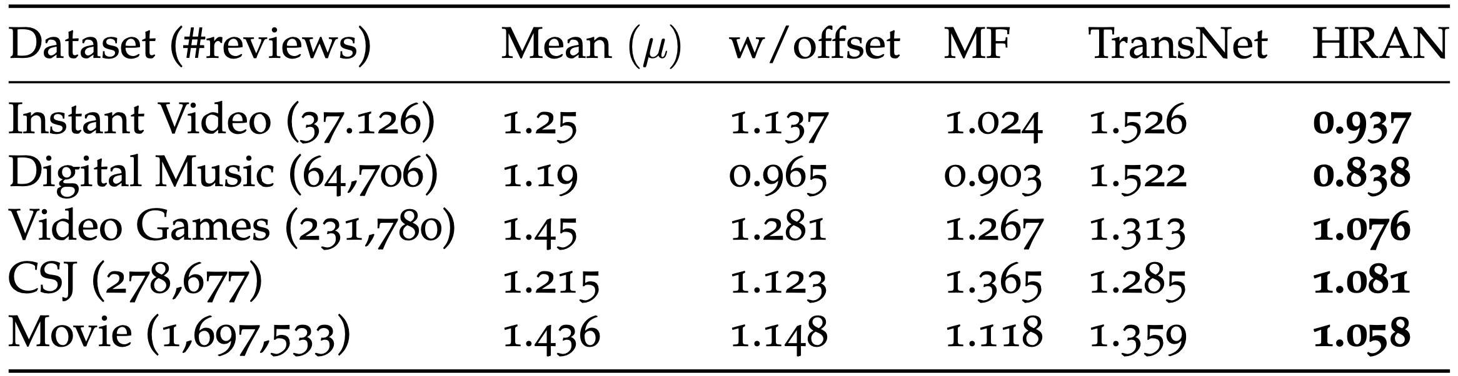
Results
[1]
RMSE in rating prediction.
Combining the user/product bias to the reviews as well as the rating prediction yields the best performances.
[1]R. Catherine et al. 2017
Notes:
Here’s the table reporting the root-mean-square error metric on the rating prediction task.
We compare our model to several baselines and a deep model, TransNet.
(The comparison with the Mean and Offset mean baselines allow us to highlight the importance of deeper models.)
(The other two models highlight the importance of combining ratings to textual reviews).
The Matrix Factorization, or MF, learns to predict the rating of user u on item I using only the rating-derived profiles of users and items, with no regard for the reviews.
The TransNet takes the opposite approach as it learns to predict the rating of user u on item i using only the textual reviews as input.
More precisely, the TransNet model learns to approximate the review of user u on item I from all the reviews written by U and all the reviews written on I.
The approximation of review u,i is then fed into a MLP that outputs the rating associated to the review.
It is worth noticing that the TransNet model achieves disappointing performances on our datasets.
This can be explained by the fact that, since it relies only on textual reviews, it needs a lot of data in order to be competitive.
It is however an interesting baseline for our experiments because it’s an original approach on recommendation that showed interesting results on larger datasets, without using the most efficient data for this task: the interactions.
Both those models are outperformed by HRAN which combines ratings to textual reviews and uses them to compute a global and a personalized attention score.

Slide 26
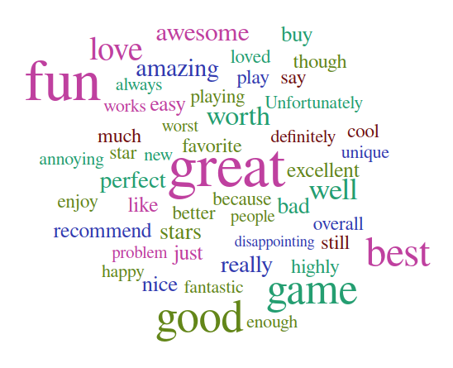
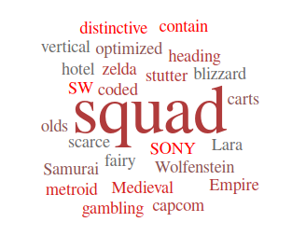
Attention Visualization, Word Level
Generalist component of attention
Personalized component of attention
Obtained by extracting (and counting)
the argmax of each (user, item, review)
attention vector.
Notes:
This slide shows examples of those attention scores.
Those visualizations were obtained by feeding the trained model every triplet of (user, item, review) in the video game dataset.
For each triplet, we retrieved the argmax of the associated general and personalized attention vectors and counted them.
The bigger the word in the wordcloud, the more often it was counted as the argmax.
On the left side are the words that are discriminant for the generalist component of the attention vector.
It mostly shows positive opinion markers, like “great” or ‘good’, as well as some words related to the dataset like “game”.
On the right side we can see the wordcloud of the personalized attention vector.
The words are much more specific to the items’ characteristics, like Zelda, Lara, medieval etc.
It is this specific information that allowed us to improve our recommendation performances.

Slide 27
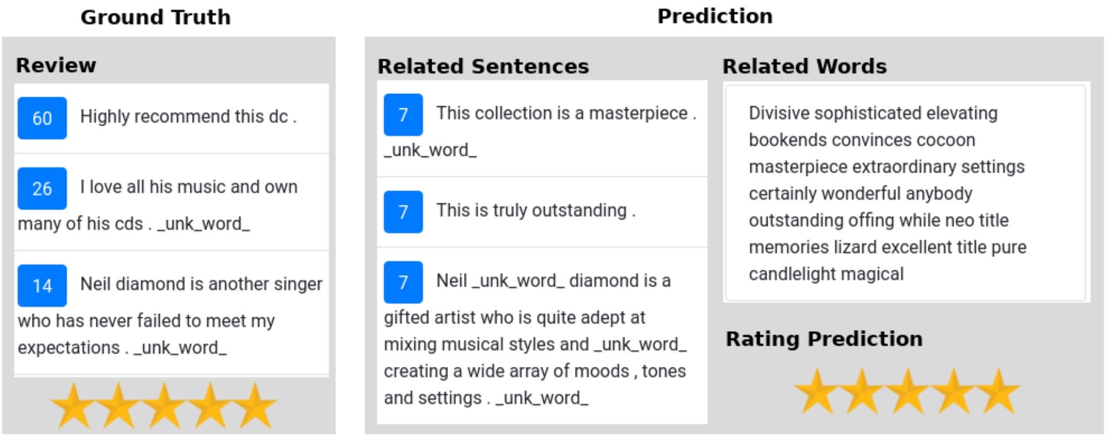
Attention Visualization
Example of attention analysis for recommendation explanation
→ Automated suggestion explanation
Notes:
We conducted similar experiments at the sentence-level.
More precisely, we ran our trained model on a user-item pair, and we presented on this slide several outputs of our model (on the right) and we compare them to the actual review and score of the current user on the target item (on the left).
Each review is broken down into individual sentences, each associated with their attention score in blue.
The different outputs of our system are
the predicted rating,
the sentences we consider useful for the current user –extracted from the reviews on the target item–,
and the keywords associated with the target.
All these outputs represent an automated way to explain the suggestion made by the system to the current user.
Aside from a correct rating prediction, we can see that HRAN also outputs highly commendable reviews written by other users, as well as descriptive key words regarding this item (such as sophisticated, elevating etc).
You can also note that HRAN attributes the highest attention score to the reviews written by the current user, which of course makes sense.

Slide 28
Conclusion
Combining text reviews and ratings
Proposes explanations to the system’s suggestions
Alleviate the Cold Start Problem
Personalized review reading model
Notes:
In conclusion, we propose a model that combines the use of ratings and textual reviews to learn a dual attention vector, allowing us to improve our performances on a classic recommendation task.
This approach also allows us to conduct a qualitative introspection of our model, thus providing explanations for the suggestions made by the system.
Additionally, the use of textual reviews can alleviate the Cold Start Problem, which prevents collaborative filtering-based models from making relevant suggestions to new users, for lack of interactions.
Finally, one can think of our model as a personalized review reading system for the users.
Once trained, the model’s attention mechanisms can highlight the relevant words and sentences within the reviews on a given item, in a way that matches the current user’s tastes.

Slide 29
AN NLP APPROACH TO PROFESSIONAL PROFILE LEARNING AND EVALUATION
Resume: A Robust Framework for Professional Profile Learning & Evaluation
Clara Gainon de Forsan de Gabriac, Vincent Guigue, and Patrick Gallinari ESANN 2020
Notes:
[18:00 – 18:30]
In the past section, we have seen how informative user-generated textual traces can be, both from a quantitative and a qualitative point of view.
In this next section, we are going to move on to a different kind of user profile, which are fully textual and a lot noisier than traditional recommendation profiles: LinkedIn pages.
The resulting framework, Resume, can however be applied to a lot of other text-oriented systems, like Twitter for instance.
This work was published at the ESANN conference of 2020.

Slide 30


Motivation & Problematic
People tend to change jobs more and more often
More and more online job boards
Notes:
The work presented in this section stems from an observation: contrary to a few decades ago, people tend to change jobs a lot more often.
Incidentally, the number of online job-boards and professional networks has kept growing.
This opens the door to new tasks and problematics:
Can we predict a person’s next career move?
Can we automatically match candidates to job offers?
Can we know what skills a person needs to acquire in order to get a promotion?

Slide 31
Motivation & Problematic
People tend to change jobs more and more often
More and more online job boards
Problematic
How can we accurately represent a person’s professional profile?
Notes:
The question we ask ourselves, which englobes the previous ones , is:
How can we accurately represent a person’s professional profile?

Slide 32
Motivation and intuition
Schematic representation of a LinkedIn Profile
Notes:
The data we use for this task are LinkedIn profiles.
Those profiles are fully user-generated and fully textual(, which means that each information on it has been typed by the user, rather than chosen from a pre-existing list.)
A user’s LinkedIn profile is composed of their professional experiences, in green, themselves composed of a job title (in bold font) and a job description.
Similarly, their educational background is composed of their degree name and the institution they got it from.
Note that for simplicity purposes, we will note address the educational background of users in this presentation.
Besides those, a user’s profile also contains the skills of a user as well as the industrial domain they work in.
(Like for the previous fields, there is no particular restriction on the content of either the skills or the industry, which makes both those fields subject to redundancy and typos.)
Now, what interests us the most about LinkedIn profiles is the amount of unstructured free text as well as the different axes present in a profile:
the professional experiences,
the skills,
and the industry.

Slide 33
Motivation and intuition
Schematic representation of a LinkedIn Profile
Intuition
We can use their LinkedIn page to build their professional profiles
Their past jobs (natural language) should be enough to represent them
Notes:
In the last section, using a user’s textual opinion led us to significantly improve our understanding of their tastes and wants.
Those results encourage us to go even one step further and explore user representation using solely user-generated texts.
With regards to professional profiles, this translates to using a user’s past professional experiences to build their professional profile.

Slide 34
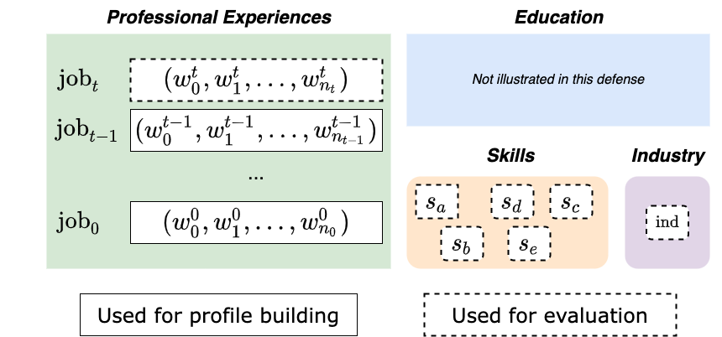
Motivation and intuition
Intuition
We can use their LinkedIn page to build their professional profiles
Their past jobs (natural language) should be enough to represent them
Approach
User-generated text → build their representation
Remainder of the profile → evaluation
Notes:
More formally, we are going to use a person’s T first jobs (from job_0 through job_t-1), in a solid line box, to build their representation,
and we will use the remainder of their profile (their last job jobT, their skills and their industry, in a dotted line box) to evaluate the amount of information encoded into our user representation.

Slide 35
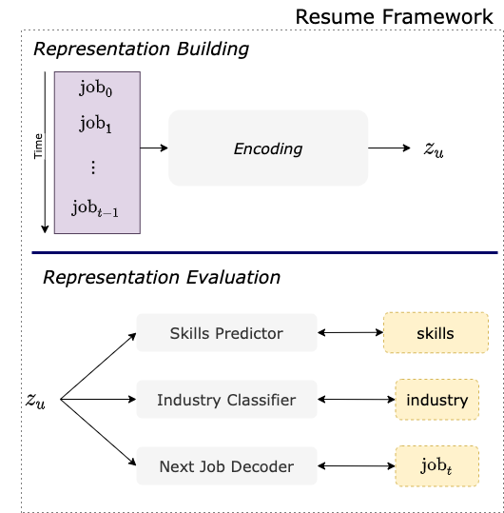
Resume overview
Approach
User-generated text → build their representation
Remainder of the profile → evaluation
Notes:
The combination of representation building and evaluation constitutes a user-representation framework that we call Resume.
The user’s jobs are used to build a representation of the user, z_u, and we evaluate how much of the professional profile is encoded in z_u by learning to retrieve
the skills
the industrial field
and the last job of the user
from their representation z_u.
But before getting into the details of this framework, let’s look at the specifics of our data.

Slide 36
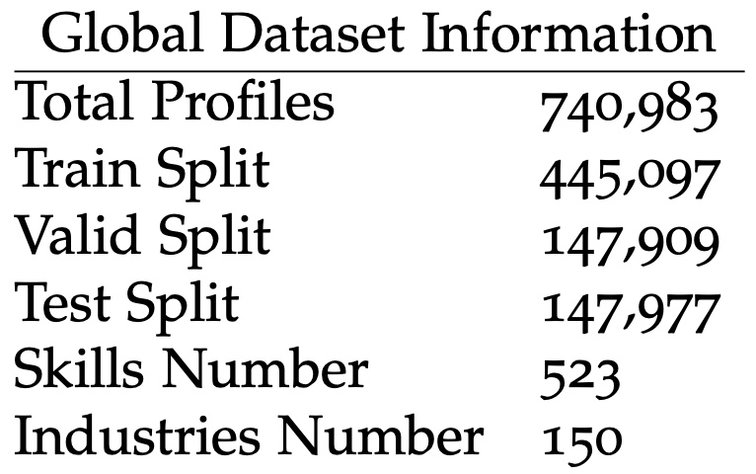
Data & Task
The data is noisy, unstructured, redundant.
Notes:
We have over 700,000 profiles.
Those profiles are characterized by their high level of noise, redundancy and overall lack of structure, being free text.
We thus pre-process our data to keep only the skills and industries that appear more than 10 times across all the profiles.
Those skills and industries will serve as labels in our classification tasks at evaluation time.
However, we cannot adopt a classification framework when it comes to predicting a person’s next job.

Slide 37
Data & Task
The data is noisy, unstructured, redundant.
Training Split Information
# Profiles | 445,097
# Jobs | 2,595,484
% Unique Jobs | 98.9%
Notes:
If we take a look at the jobs of the train split, we realize that almost 99% of them are unique.
When we think of it, it is not very surprising because we consider both the job title and the job description, and it is normal that different people would write about their professional experiences with different words, even though those experiences would be similar.
For this reason, we address the task of last job prediction as a text generation problem, rather than a classification one.
That being said, and while the generation approach is more suited than the classification one, it is not a trivial one because of the nature of our data.

Slide 38
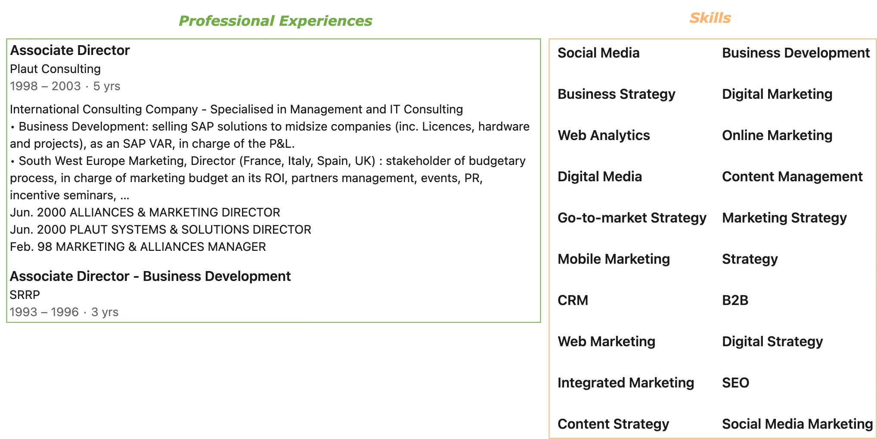
Data - Example
Non-verbal sentences
Acronym
Abbreviations
Named entity
Possible typos…
Redundancy
Notes:
This slide illustrates the previously mentioned noisiness and specificities of our data.
Regarding the Professional experiences, they are formatted in a very specific way: they are full of
non-verbal sentences,
acronyms,
abbreviations,
named entities and so on,
which makes them harder to handle than regular natural language datasets.
In parallel, the skills of a user often show redundancy.
They are redundant because it is in the interest of the user to fill out as many skills as possible, so as to appear on as many recruiters’ searches as possible, yielding situations like the one illustrated where we have « mobile marketing», « web marketing », « integrated marketing » and so on next to each other.
As a reminder, we learn how to retrieve the skills, the industry, and the last professional experience of a user profile from their representation.
Of course, learning to predict a person’s last job is a practical proxy for predicting their next job.
Taking a closer look at our data highlights that this task is necessarily skewed by the fact that people’s resumes often reflect their career goals at time t.
That is to say that their LinkedIn pages are filled with period-specific buzzwords, be it in their skills or job descriptions, and angled at the kind of position they aim for.
However, these observations do no stand in the way of the tasks we address in this work, and it is still reasonable to consider them good ways to evaluate the user's profile.
To sum up, we are handling a very specific type of data which is as rich as it is challenging.

Slide 39
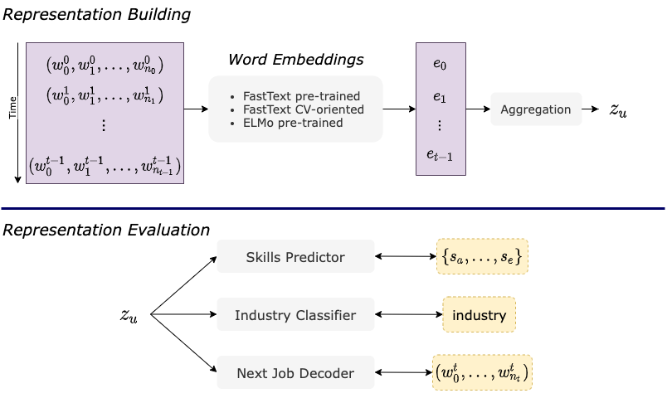
The model : Resume
Notes:
If we get back to the framework overview, we can see that it is separated in two: the representation building part, and the representation evaluation part.
In the representation building part, the professional experiences are fed into a word embedding model, and then aggregated into z_u, the user’s representation.
We compare 3 word embedding models.
The first 2 are FastText models.
FastText Pre-trained (or FastText_PT for short) denotes a model that was pre-trained on large standard datasets in French.
The second one, FastText CV-oriented (or FastText_CV) was trained on our own data.
Finally, we use an ELMo model that was pre-trained on French corpora.
Regarding the job representations’ final aggregation, we tried several forms of pooling as well as some more complex forms of learnt aggregations.
Average pooling is the one that got us the best results.
If we take a look at the evaluation part, we can see that it is composed of three models: the skill predictor, the industry classifier and the next job decoder.
The two first models are 2-Layers MLP trained to retrive the skills and the industrial domain from z_u, respectively.
The Next Job decoder is a recurrent model which architecture is going to be detailed later on.
Let us now get into the details of the embedding models we used.

Slide 40
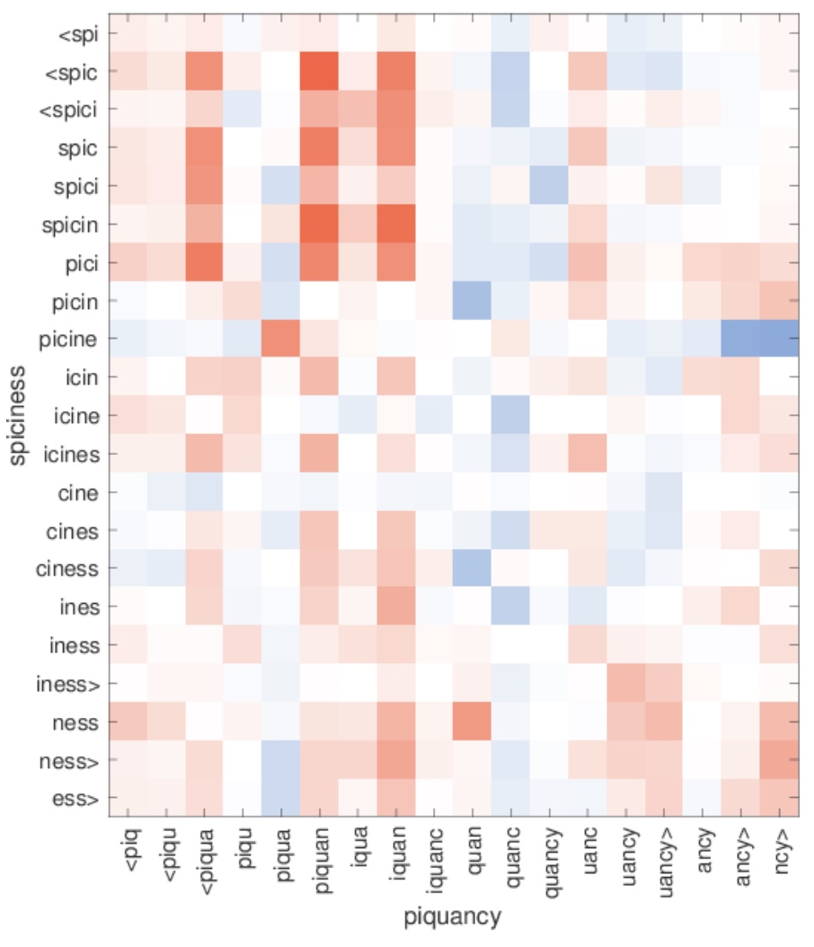
Related work - FastText
Enriching Word Vectors with Subword Information
Bojanowski, Piotr and Grave, Edouard and Joulin, Armand and Mikolov, Tomas
ACL 2016
Sub-word embeddings
Great for out-of-vocabulary words
Very fast to train
Similarity between character n-grams in out-of- vocabulary words.
Notes:
The FastText model Builds on the work of word2Vec, and addresses its main limitation: the handling of OOV words.
FastText does so by using subwords embedding, and then computing the embedding of a word as the average of its subwords embeddings.
An exemple of this process is illustrated on the right hand side of the slide.
It shows the similarity between n-grams of an OOV word, piquancy, and the ngrams of a word seen at training time, spiciness.
The red color indicates a high cosine similarity, which is used in the paper to evaluate the relevance of the learned sub-word embeddings of OOV words w.r.t. those of words seen in the training set.
We can see that the embedding of the n-gram “piquan” is very similar to the of the ngram “spicin”, which is a good hint regarding the OOV word’s final embedding.
In our case, this handling of OOV words is especially useful to tackle typos and named entites in our data.
It is worth noting that FastText embedding models are very Fast To train as they are not recurrent.

Slide 41
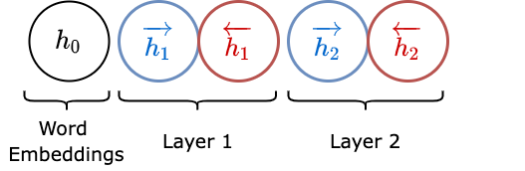
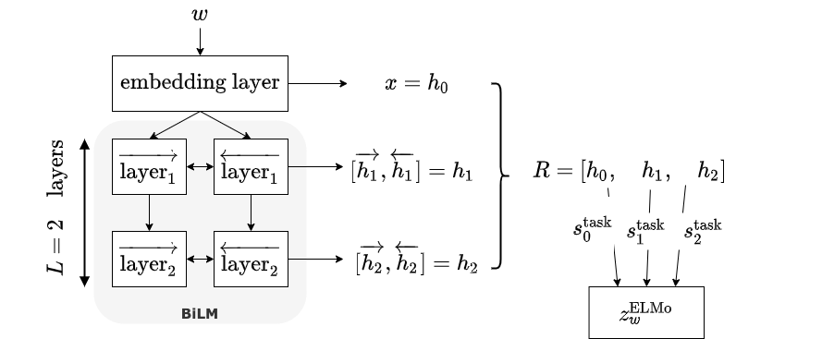
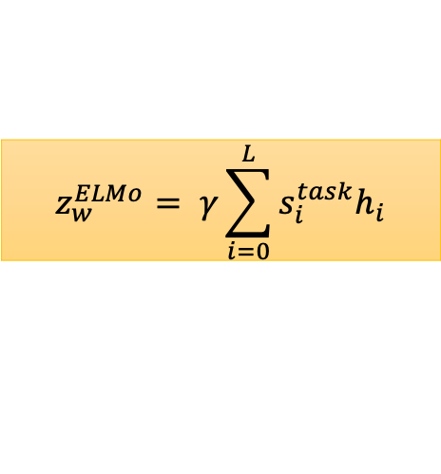
Related work - ELMo
Deep contextualized word representations
Peters, Matthew E. and Neumann, Mark and Iyyer, Mohit and Gardner, Matt and Clark, Christopher and Lee, Kenton and Zettlemoyer, Luke.
In: Proc. of NAACL 2018.
$$z_{w}^{ELMo}= γ\sum_{i=0}^{L}{s_{i}^{task}h_{i}}$$
Notes:
ELMo on the other hand, presents contextualized embeddings that rely on a pre-trained bidirectional Language Model, or BiLM.
Both the forward and the backward components of this BiLM have L=2 layers.
Once the BiLM is trained, each token w is fed to the the BiLM and associated with a set of L+1 representations, which is aggregated into a single, final representation z_w^ELMo.
This final representation is a weighted sum of the previous L+1 representations, and the ponderations s_i^task are learned during a fine-tuning process on the downstream task.
Peters et al. motivate the number of 2 layers for the biLM components by the fact that the first layers capture low-level information such as syntax for POS tagging, while the second layers extract context-dependent aspects of word meaning, thus performing word-disambiguation.

Slide 42
The model : Resume
[1] Rush et al., 2015
Notes:
Now that we explained what word embeddings we used, let’s take a closer look at our next job generation task.
Our approach to text generation is close to the task of abstractive summarization, as we aim at first understanding a person’s career in a professional representation and then, at generating this person’s last job.
Text generation is known to be a computationally expensive task, as well as a hard one to evaluate, as we will detail later on.

Slide 43
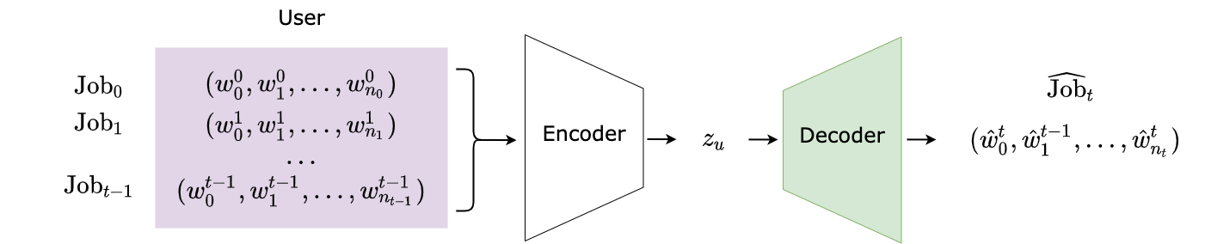
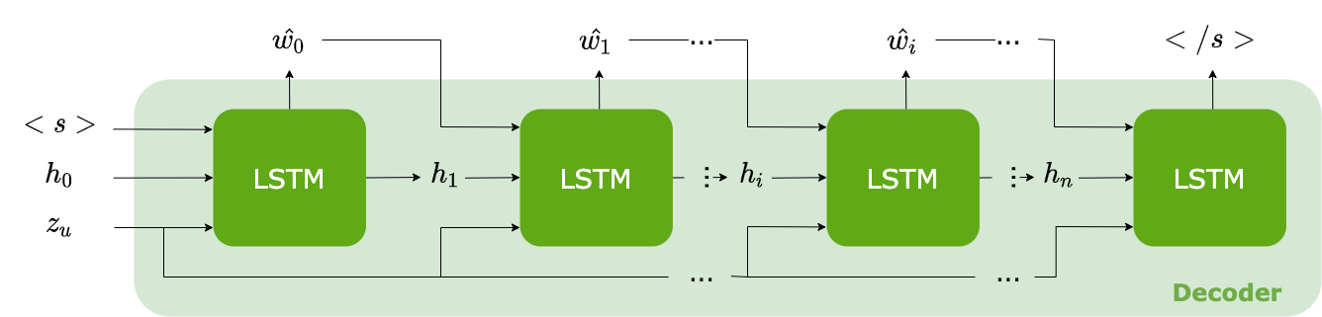
The model : Resume
Illustration of the Text generator
Illustration of the Decoder [1]
[1] I. Goodfellow, Y. Bengio, A. Courville (2016)
Notes:
The user profile is built by encoding their T first professional experiences (or jobs).
Then, a decoder is trained to generate the user's last job, Job_t.
Note that a new decoder is trained for each word embedding we compare.
The decoder takes the form a LSTM cell and is trained using a variable teacher forcing method.
Let's now move on to the results of the experiments.

Slide 44
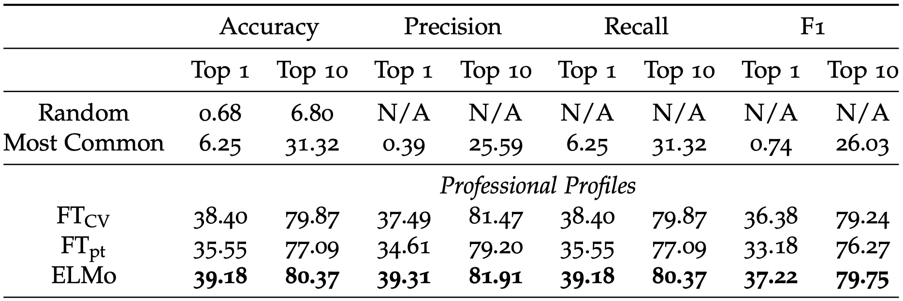
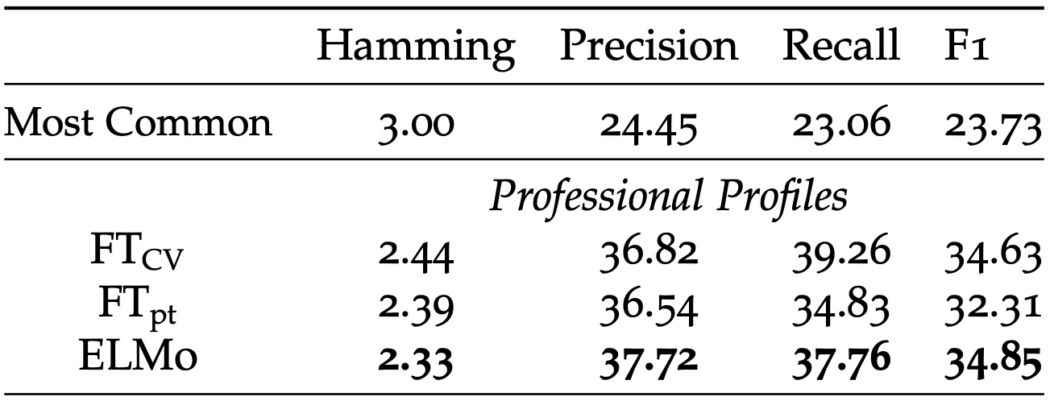
Results - Classification
Industry classification results on 150 classes.
ELMo gets best performances
But FT_CV is still competitive
Skills Prediction Results on 523 classes
Notes:
This slide presents the results of the experiements on the industry classification task and the skill classification task.
The three word embedding models described earlier are compared to more trivial baselines such as the most common class or classes, and a random prediction in the case of the industries.
The results show that ELMo outperforms the FastText models, probably due to its ability to disambiguate words.
Its is however interesting to note that the FastText model we trained on our data, FT-CV, is very competitve with ELMo.
Before going over our text generation results, let’s take a look at the BLEU score, the traditionnal metric to evaluate generated text.

Slide 45
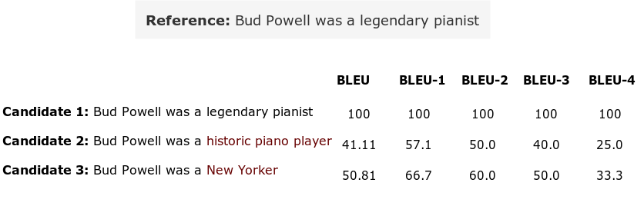
Next Job Generation – BLEU score
Illustration of the BLEU[1] score
Limitations
Semantic is not measured.
Poorly formed sentences can still get a good score.
[1] Papineni et al., 2002, [2]Callison-Burch et al., 2006
Notes:
The BLEU score, introduced by Papineni et al., evaluates how many of the n-grams in the candidate sentence appeared in the human reference, with respect to the candidate's length.
The BLEU score can be divided into BLEU-1 through BLEU-4, each metric respectively accounting for the number of unigrams through four-grams that the candidate has in common with the reference.
An example is presented on this slide.
When comparing the first candidate sentence to the reference, “Bud Powell was a legendary pianist”, we get a perfect BLEU score because both sentences are identical.
However, when we compare the scores of candidates 2 and 3, a major flaw of the BLEU metrics stands out: although candidate 2 is semantically closer to the reference than candidate 3, it obtains a lower BLEU score due to having one more word than the reference.
Furthermore, Callison-Burch et al. argue that the shuffled variations of a predicted sentence would get the same BLEU score despite not being syntactically, grammatically or even semantically equivalent.
That being said, and while there is active research conducted in the field to better evaluate generated texts, there is no satisfactory alternative to this day, so we will use the BLEU score keeping its flaws in mind.

Slide 46
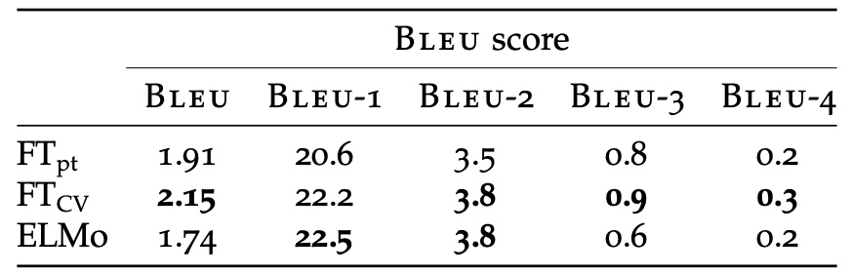
Results – Next job Generation
Experimental results on job generation (title & description)
The BLEU score: syntax, not meaning
FT_{CV} outperforms ELMo and FT_{pt}:
a CV is not traditional natural language.
Notes:
Now that we illustrated the BLEU score, let’s move on to the results of the next job generation experiments.
Our experiments show that the FT_{CV} model outperforms ELMo and FT_{pt,} which can probably be explained by the fact that a CV is not traditional natural language, and thus, that the language model of ELMo is of little help to encode a sufficient amount of the user’s professional profile.
All in all, this next job generation scores highlight the difficulty for our models to generate long job descriptions as well as very specific sentences.
Here are some examples.

Slide 47
Results
Illustration of text generated by our decoder
Ground Truth
E-commerce Consultant. My mission consists in reaching the goals set up by the clients regarding their profitability and/or notoriety issues […]
FastText pre-trained
Marketing Manager. Management of the client relationship, Social networks management, Social networks management […]
FastText CV-oriented
Marketing Manager. Managing the communication strategy and the communication strategy for clients […]
ELMo
Sector Manager. Management of the client relationship, UNK, stock management, stock management[…]
Notes:
In this example, the user’s actual last job is the one marked as ground truth: “E-commerce Consultant. My mission consists in reaching the goals set up by the clients regarding their profitability and/or notoriety issues".
The 3 models do express the marketing aspect of the job, which means they all could somehow capture the career evolution of the user, since all models only had access to the person’s previous jobs.
Besides, all models have captured the writing style of a CV, with short non-verbal groups or sentences.
Additionally, It is interesting to note that, even though all models seem to get stuck in a generation loop, the FastText CV model expresses the communication aspect where the other models see a client relationship management aspect.

Slide 48
Conclusion
New task: Professional Profile Learning, and New application Domain: Human Resources
Addresses new challenges
Many possible applications [1]
New framework for User Representation: Resume
Text-based, versatile
Provides several axes of evaluation: improved understanding
[1] https://ec.europa.eu/esco/portal/home
Notes:
In conclusion, we propose a new task, professional Profile learning, in a new domain: Human Resources.
This task addresses a whole new set of challenges revolving around professional profiles, which are to this day little to not studied.
This new domain opens the way for a lot of exciting applications, such as job coaching or applicant selections, especially if we could combine our work with existing European standard nomenclatures, like ESCO.
We also propose a framework for user Representation, Resume.
It uses the natural language elements of a user profile to build a user representation, and then uses the remainder of the profile to evaluate it.
The different evaluation tasks, namely the text generation, provide a range of different aspects to evaluate and thus, a more comprehensive overview of the learned representation.
Of course, we are aware of the ethical questions raised by the use of such sensitive data in such a sensitive domain, and we do not consider that future work on this field can be soundly conducted without the help of experts.

Slide 49
USER DYNAMIC MODELING
Exploratory work
Notes:
[34:00 – 34:30]
In the past section, we have laid the ground work for professional profile learning, by using the free text data in the profiles.
A way to improve our professional representation that comes to mind, is to take into account the fact that people may gain experience during their career, and that this experience impacts how their career evolves.
Additionally, it seems reasonable to think that the industry that a person works in also impacts their career evolution.
For instance, a 2012 survey from the French government reports that the turnover (that is to say, the number of people who changed companies in the year) in companies of services is almost 3 times higher than the turnover in construction-oriented companies.
So, in this following section, we present intuitions and exploratory works that aim at modeling the expertise level and the industrial domain of a user at time t, so as to improve their professional representation, and thus, improve the quality of our predictions regarding their careers.
Note that the works presented in this section are incomplete in the sense that we did not achieve significant results for reasons that we explain before the conclusion.
In the past section, we have implicitly assumed that people evolved in their career uniformly with time, regardless of their industrial domain or their expertise level.

Slide 50
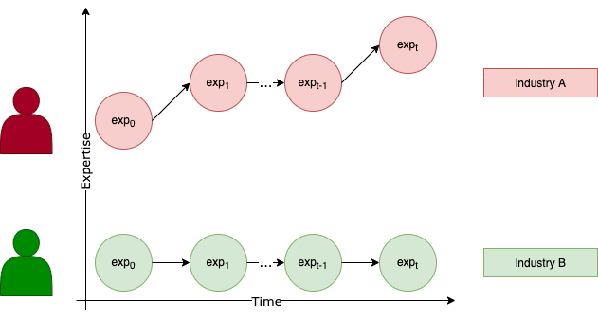
User Dynamic Modeling
Let’s model expertise and industry explicitly.
People change with time
Their expertise too [1]
Depending on their environment
People change differently
Depending on their personality
[1] J. McAuley and J. Leskovec (2013)
Notes:
Rather, in real life, people’s career do change with time, because they might want to change professional path, but also with their expertise level, as previously discussed by McAuley and Leskovec, who decidedly provided a lot of material for this thesis.
On top of possibly changing their career goals as their expertise grows, people’s careers are also subject to their environment’s (or industry’s) own dynamic, as well as the person’s own personality.
As we mentioned earlier, the perspective of evolution and the turnover vary a lot from one industrial domain or another, and it seems reasonable to think that it can also vary from one person to another within the same industrial domain.
(Of course, one can think of other factors that can impact a person’s career, like the size of the company, the person’s location, their age, their gender etc., which we will not address here either because we do not have the relevant data, or because we find the current objective to be ambitious enough.)

Slide 51
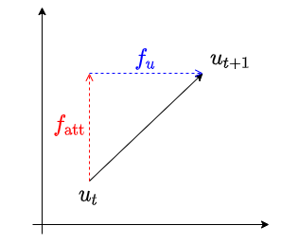
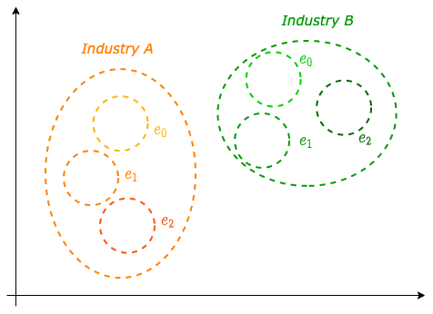
User Dynamic Modeling : Outline
Let’s model expertise and industry explicitly.
Job Attribute Rewriting
Latent Space Structuring
Notes:
In short, what we aim at doing in this section is to understand how the users change in order to best predict their future behavior, by explicitly modeling their expertise level and industrial domain.
Doing so on a few domains could allow for a transfer learning approach to new industries, which could namely be used to help a person reorient themselves professionally.
We present 2 approaches to this problem, one called Job Attribute Rewriting, based on a back-translation mechanism, and a second one, Latent Space structuring, based on Variational Auto Encoders.
In the Job Attribute Rewriting setting, we aim at rewriting a job’s attributes; that is to say, the industry or the level of expertise associated with this job.
This rewriting will allow us to disentangle the attribute’s component from the user’s personality component in their career trajectory.
The latent space structuring approach rather aims at structuring the space in which the jobs representations live according to both their industry and their expertise attributes, so as to learn people’s trajectories more easily.
Let’s start with the Job Attribute Rewriting setting.

Slide 52
Job Attribute Rewriting
Intuition
People in different industries have different career evolutions
The level of expertise of a person can change and influence their career
Disentangling
the industry from
the expertise level of a job
will help us understand
the user’s trajectory.
Notes:
The idea of the Job Attribute Rewriting model stems from the fact that people in different industries have different career evolutions, and that their level of expertise will change and influence their career.
Typically, a person that starts a job and gains expertise in their field is more likely to gain a promotion than someone who does not acquire any expertise.
Note that, similarly to McAuley and Leskovec, we assume that the expertise of a person cannot decrease with time (we will refer to it as the monotonic assumption).
It can however never increase, for instance in the case of a person who only has student-like type of professional experiences.
It doesn’t mean they didn’t learn anything, just that their knowledge is not really translatable to a particular industry and thus seldom turns into a promotion, or a more advanced position.
With that in mind, the goal of the Job Attribute Rewriting architecture is to learn to disentangle the industry and the expertise level of a given job from the user’s personality, in order to learn what really pertains to the user in their career’s dynamic.

Slide 53
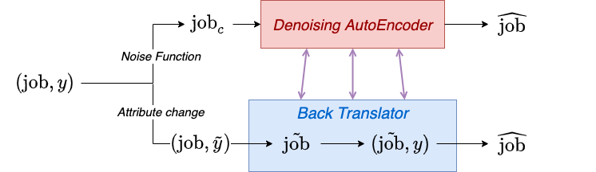
Job Attribute Rewriting
Training:
[1]
[1] R Sennrich et al., (2015)
Notes:
This architecture is based on two blocks: a denoising auto-encoder, and a back translator(, as introduced by Sennrich et al.)
In this schema, the term “job” refers to a professional experience, and the “y” corresponds to an attribute, either the expertise level or the industry associated with the job.
At training time, the denoising autoencoder is trained to output the original job from a corrupted version.
In parallel, the back translator is trained to sequentially rewrite the original job j according to a new attribute y_tilde into job_tilde, and finally, to rewrite job_tilde according to the original attribute y into the original job.
This back-translation approach is a great way to circumvent the fact that we do not have a supervision for job_tilde.
Both those modules actually have the same weights, which means that this model learns to rewrite a job given a certain attribute while ensuring that the latent representations do not collapse.

Slide 54
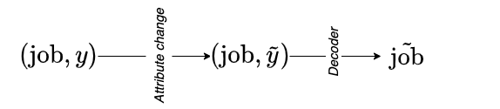
Job Attribute Rewriting
Training:
[1]
Inference:
[1] R Sennrich et al., (2015)
Notes:
Once this model is trained, we can rewrite any job with another attribute, be it expertise level or industry.
Now, the architecture we propose is directly inspired from Lample et al. 2019, who propose a way to handle several attributes at the same time by embedding and averaging them.

Slide 55
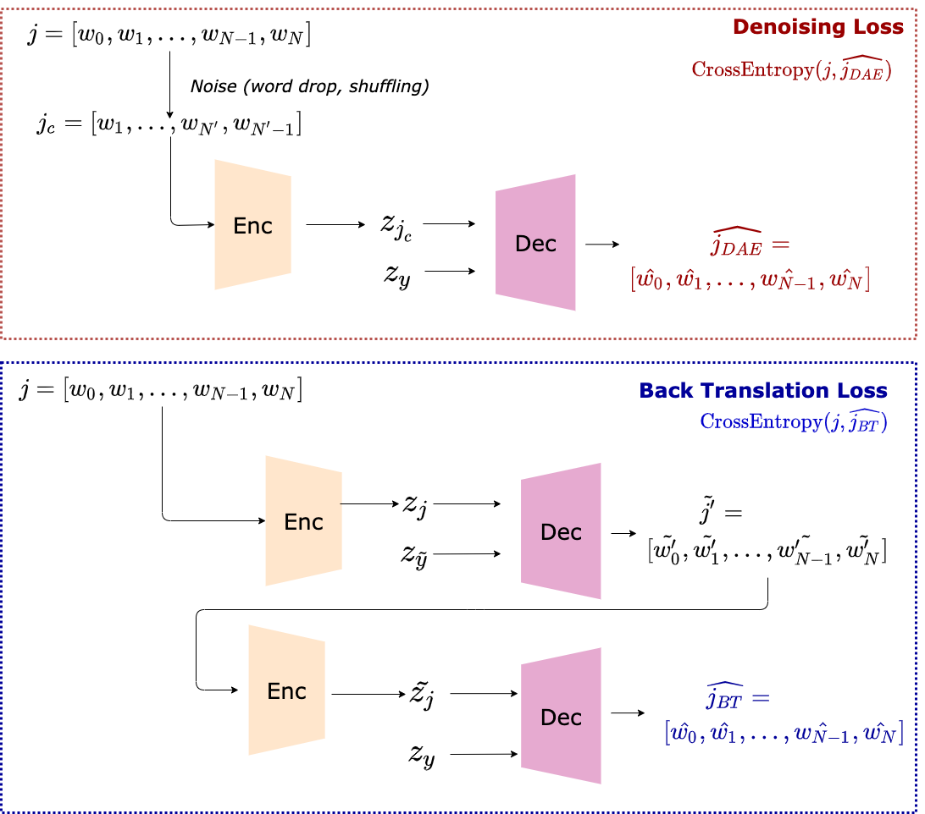
Job Attribute Rewriting
Multiple-Attribute Text Rewriting
G. Lample, S. Subramanian, E. Smith, L. Denoyer, M’A. Ranzato, Y-L. Boureau
In: Proc. of ICLR 2019
Notes:
This is a more complete illustration of the architecture, which depicts the role played by both the encoder and the decoder in the denoising part and the back translation part.
You’ll notice that the attribute “y” is now denoted “z_y” because it is embedded, and their representations change with backpropagation.
(The model is thus trained by optimizing a mixture of CrossEntropy Losses, one regarding the denoising part, and the other, the back translation part.)
Evaluating this model is however not trivial, as it never is trivial to evaluate generated text.
Lample et al. propose to combine a classification metric to a BLEU score and a perplexity score.
(The classification metric checks if the intended attribute can be retrieved from the generated job, while the BLEU score measures how much of the original job was kept.
Finally, a perplexity score measures the generated text’s fluency and ensures we did not generate unintelligible text.)
It is interesting to not that this model performs attribute rewriting rather than attribute disentanglement.
This means that we cannot directly get a career dynamic for a person independently from an industrial domain or an expertise level.
These limitations are addressed by the next architecture: the latent space structuring.

Slide 56
Latent Space Structuring
Intuition
People in different industries have different career evolutions
The level of expertise of a person can change and influence their career
Enforcing structure in the latent space will help us navigate it
Notes:
This approach to user dynamic modeling is to structure the latent space in which the professional experiences live, in order to learn a trajectory model.
We will do so by training a Conditionnal Variationnal Auto Encoder.

Slide 57
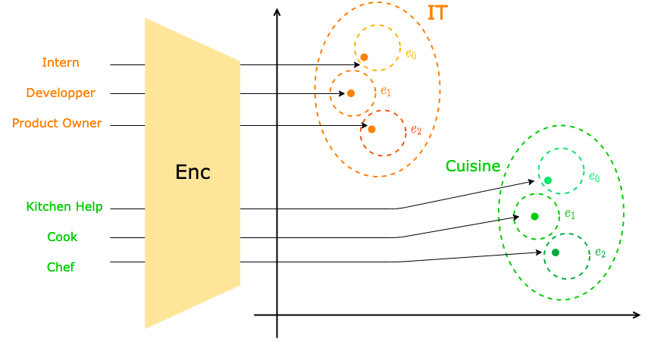
Latent Space Structuring
Illustration of the structured latent space
Notes:
Going from the idea that career progression varies from one industry to another, our intuition is that enforcing this separation will improve the latent space quality and ease the learning of users’ trajectories.
This structuration of the latent space will happen on two levels.
The higher level of structuration will be the industry, so, typically, all information technology jobs would be in the same region of the space, separated from, for instance, the cooking jobs.
The second level of structuration would be internal to the industrial domain and would represent the level of expertise within a given field.
So entry level jobs that require no expertise, labelled “e0” on the schema, will be close to one another, while the higher positions will be in another region of space.

Slide 58
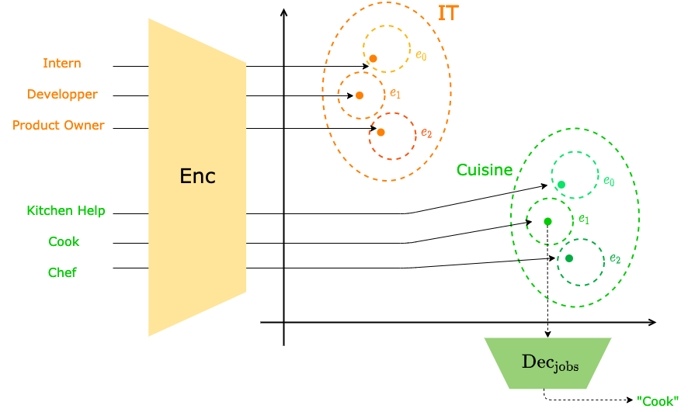
Latent Space Structuring
Illustration of the structured latent space
Notes:
Once the Conditional Variationnal AutoEncoder has converged, we would train a decoder to output the word sequence corresponding to the original input job from the latent space point.
This decoder is necessary to get understandable user trajectories in the form of generatex text.

Slide 59
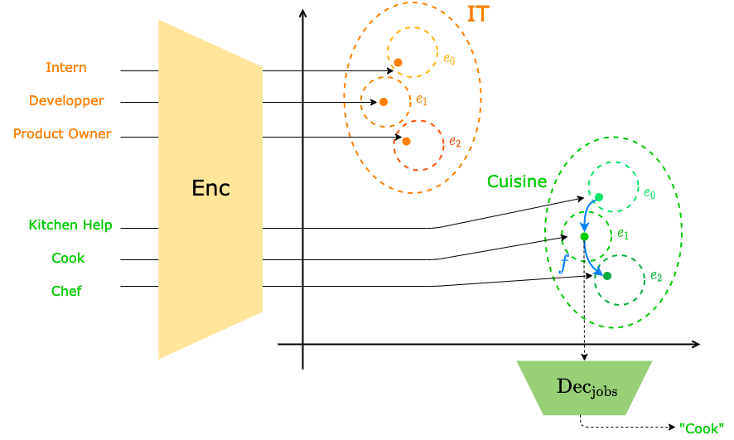
Latent Space Structuring
Illustration of the structured latent space
Notes:
Our intuition is that once the latent space is adequately structured, we could train a model that would learn how to model a trajectory from one point in the space to another.
Coupled to the job decoder we presented in the previous slide, this trajectory model would give an explicit career for a person.
Such a setup could also allow us to conduct qualitative analysis on the impact of a first job rather than another on a person’s career, as well as on the different dynamics between industries.

Slide 60
User Dynamic Modeling - Conclusion
Understanding how users change
in order to best predict their future behavior
Job Attribute Rewriting
Good proxy for next job prediction, individual dynamic.
Latent Space Structuring
Good approach for industry dynamic and career volatility.
Interests
Improved professional profile
Explainability through generation and explicit factors
Notes:
To conclude this section, the two models we presented are interesting leads on User Dynamic Modeling.
The Job Attribute Rewriting model could allow us to rewrite any job with a different attribute value.
This approach provides a good method for next job prediction, as well as isolating people's individual dynamic.
The Latent space structuring approach, complementarily provides a direct way to analyze the dynamics of industrial domains, and it would also allow us to evaluate the impact that a given first job has on a person’s career.
Those approaches could provide improved, more precise professional profiles while also providing explainability through explicitly modeled factors, on top of outputting generated text.

Slide 61
User Dynamic Modeling - Obstacles
Understanding how users change
in order to best predict their future behavior
Job Expertise Rewriting
Good proxy for next job prediction, individual dynamic.
Latent Space Structuring
Good approach for industry dynamic and career volatility.
Interests
Improved professional profile
Explainability through generation and explicit factors
Obstacles
Noisy and unstructured data
Lack of supervision on expertise level
Insufficient data
Difficult evaluation
Notes:
However promising, those works remain unfinished for several reasons.
First of all, as we previously said, the profiles we have are very noisy and unstructured, which makes them hard to properly encode and decode.
More critically, we have no direct supervision on the expertise level associated with a professional experience.
We tried some trivial expertise labeling techniques but they proved inconclusive, which of course hinders our chances at more complex dynamic modeling.
Incidentally, the pre-processing we applied to our profiles significantly reduced the size of our datasets.
While various attempts to balance the pre-requisite have been tried, it systematically led to a drastic, possibly fatal, reduction of the dataset's size.
Finally, those architectures suffer from the fact that they are hard to evaluate because they generate text.
Evaluating the relevance and meaningfulness of generated text is to this day a challenge faced by the community, as demonstrated by the evaluation protocol proposed by Lample et al.

Slide 62
Conclusion
Notes:
[42:00 – 42:30]
Let us now conclude this presentation.

Slide 63
Contributions
Natural Language for refined, explainable user representation
A new task in a new application domain
An NLP-based user representation framework
Notes:
In this thesis, we explored ways to leverage user-generated texts to refine and explain user representations.
We wanted to take advantage of this widely available data in order to improve user experience with AI systems both from a quantitave point of view, by making relevant suggestions to users, but also form a qualitative point of view, by proposing explanations for said suggestions.
Our work with recommendation and textual reviews allowed us to apprehend the richness of user-generated textual data, and thus led us to build user representation from fully textual profiles in a new application domain: professional profiles learning for Human Resources.
We addressed this task by developing a versatile NLP-based user representation framework that can be applied to a lot of different systems, as long as they contain user-generated texts.
To sum up, we leveraged very sparse data and aggregated them into the same latent space via NLP methods, which allowed us improve our understanding of people’s trajectories as well as our capacity to explain our predictions.

Slide 64
Perspectives
Update existing models with newer architectures
User Dynamic Modeling
Explicit Modeling of Other Job Aspects
Diversify training objectives
Ethical Questions
Notes:
Tof course, the works details during this presentation could benefit from a number of improvements.
The most immediate ones are to update the existing models with newer architectures such as the transformer-based ones, as well as the presented leads to user dynamic modeling.
The pre-trained quality of Transformer models could not only speed up the training process, they could also improve the performances of our generative models because they would already have learned the generalities of Natural Language, and would only need to adapt to the CV’s language specificities.
Other possible improvements include the explicit modeling of other job aspects, like the company it takes place at, the time spent there and so on.
Naturally, the more profile elements you take into account the more you are likely to model various components of a professional experience, which can also be enforced by diversifying the training objectives in a multi-task learning fashion.
Finally, and while we did not mention those questions in this presentation for timing reasons, the work presented in this thesis could highly benefit from the expertise of Human Resources Experts in order to tackle the ethical questions raised by the use of AI in their field.
Although we firmly believe that works like those we presented could benefit people, both from the applicant and HR sides, it would be naïve to dismiss the fact that they can also be used to perpetuate discriminations that are already way too common in the job market.
While it is surely our responsibility as scientists to ensure the fairness and Explainability of our models, we cannot achieve satisfactory results without the help of the people who actually know how those things work and why.

Slide 65
Thank You!
Publications:
RNN & modèle d’attention pour l’apprentissage de profils textuels personnalisés. C.-E. Dias, C. Gainon de Forsan de Gabriac, V. Guigue, P. Gallinari. CORIA 2018
Resume: A Robust Framework for Professional Profile Learning & Evaluation C. Gainon de Forsan de Gabriac, V. Guigue, P. Gallinari. ESANN 2020.
Notes:
Thank you very much for your attention, I’ll now be happy to answer any question you have.

Slide 66
Appendices

Slide 67
Appendix for HRAN

Slide 68
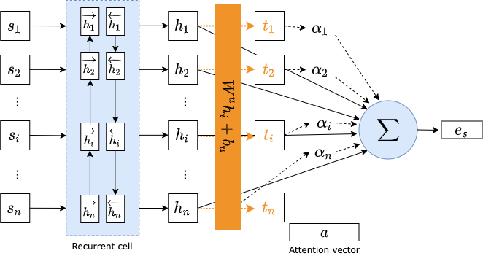
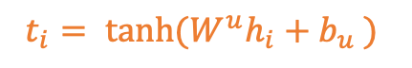
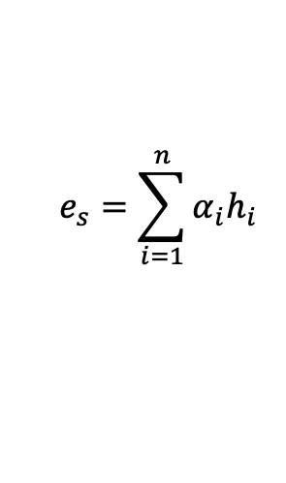
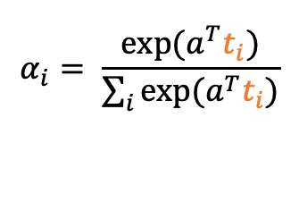
The model : HRAN, RBA – our version
Modification: we project the $h_{i}$ before computing the affinities.
$$e_{s}=\sum_{i=1}^{n}{α_{i}h_{i}}$$
$$t_{i}= \tanh{(W^{u}h_{i}+b_{u} )}$$
$$α_{i}= \frac{exp⁡(a^{T}t_{i})}{\sum_{i}{exp⁡(a^{T}t_{i})}}$$

Slide 69
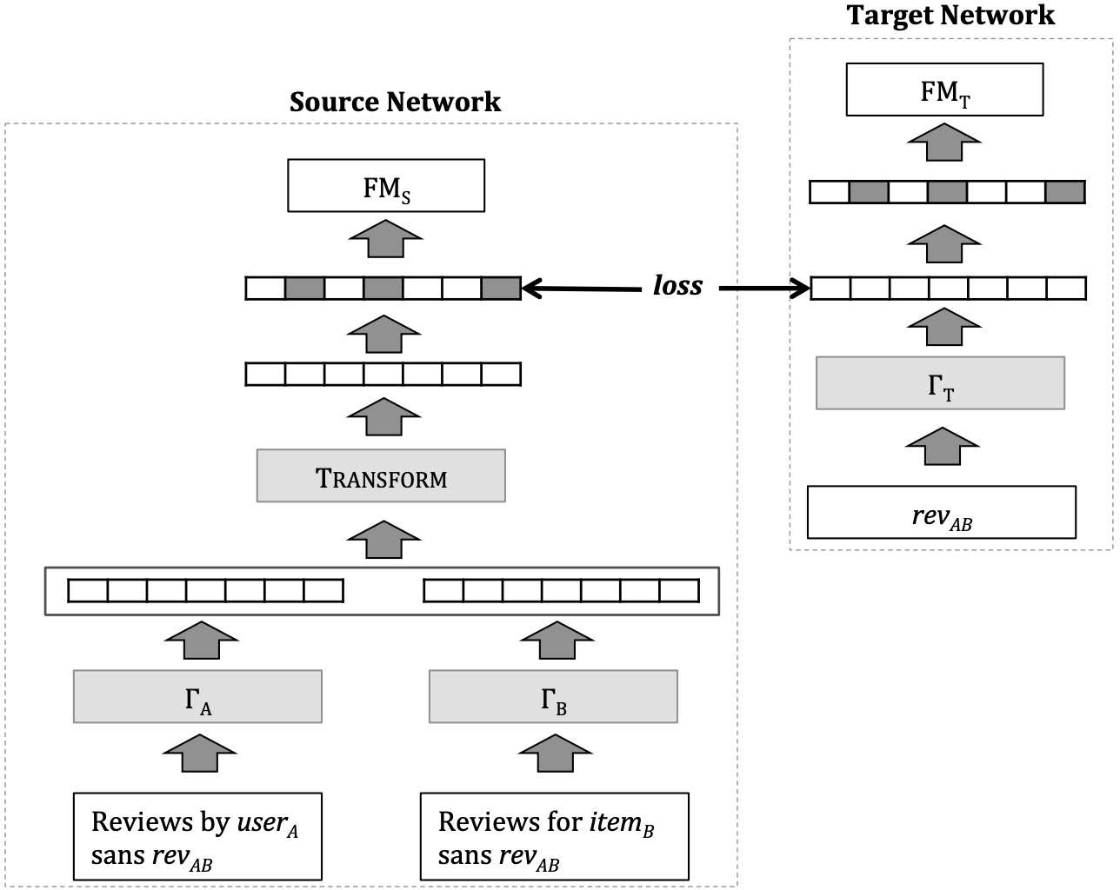
TransNet illustration

Slide 70
Appendix for Resumé

Slide 71
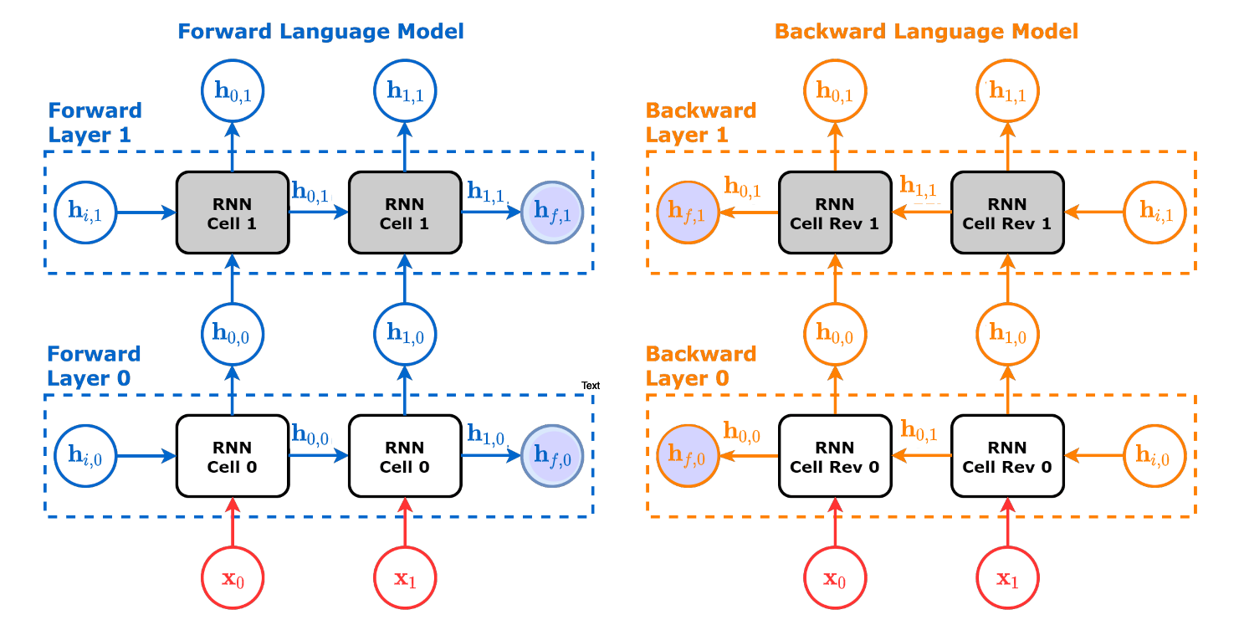
ELMo Architecture - detail

Slide 72
Appendix for User Modeling

Slide 73
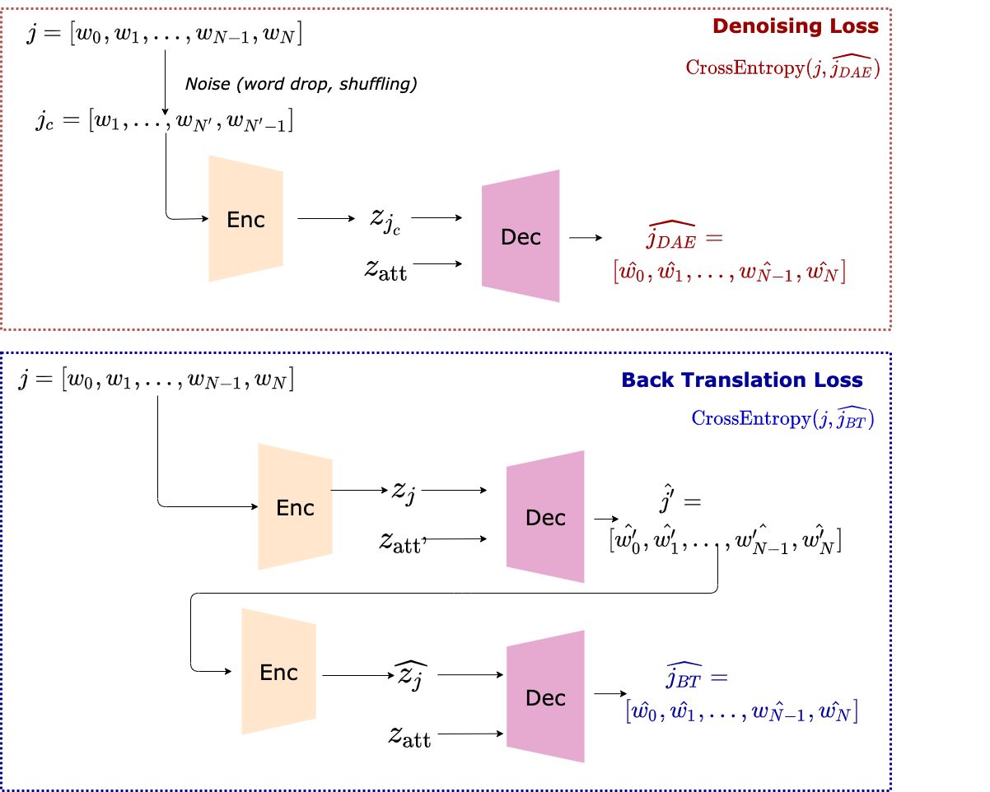
Job rewriting architecture
Illustration of the global architecture

Slide 74

VAE Training
Illustration of the global architecture

